Slide 1

ISE 490 - Spotify Machine Learning Data Analysis
By: Christopher Cajamarca and Nick Katzenberger

Slide 2
Introduction
Spotify is used by thousands, if not millions of students who listen to a variety of music.
We wanted to see how certain genres of music compare in popularity such as:
Year Released
Tone
Total Length
Using this data, we will create classification models to understand relationships between the various categories the Kaggle dataset used.

Slide 3
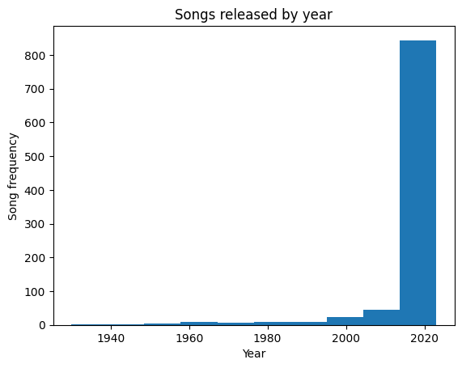
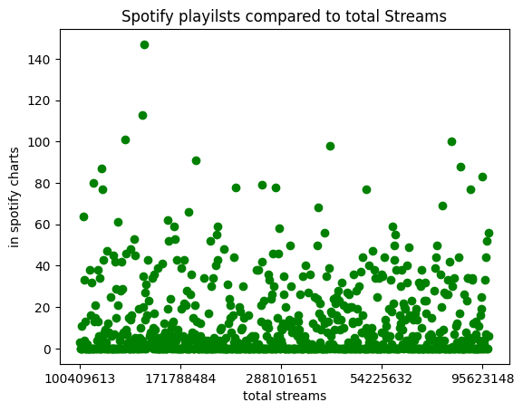
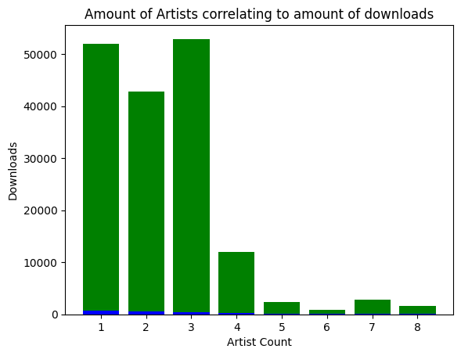
Data Description
Obtained Dataset from Kaggle
Name of Dataset: “Most Streamed Spotify Songs 2023”
Includes columns describing:
Name of the songs
Key & Mode songs are played in
Artists names
Downloads
Ratings of bpm, valence, energy level, acoustic-ness etc.
Subjective ratings realized by numerical data
Apple
Spotify

Slide 4
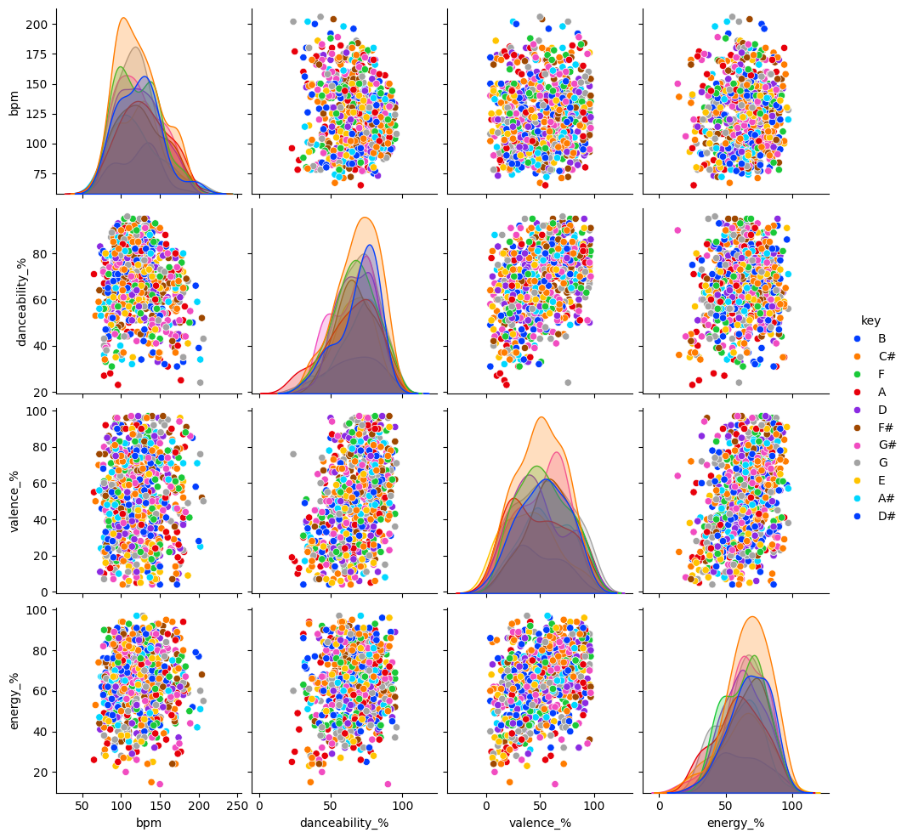
Pairwise relationships in dataset
Seemed like data points would correlate
Data was originally all over the place and unsorted

Slide 5
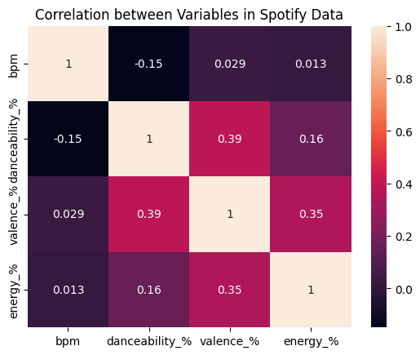
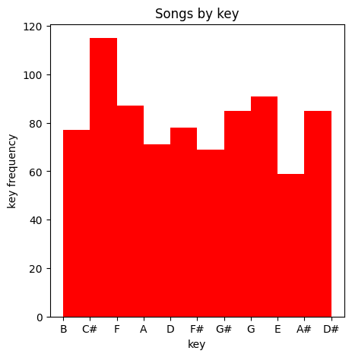
Data Processing
Filtered Out items with null or unlisted values
Graphed most correlational data
Set expectations
Converted Keys into a numerical dataset 1-10 in order to use different Machine Learning algorithms & graph them
Utilized heatmaps to visualize correlation between data columns
Used scikit learn’s train_test_split to create training and testing data

Slide 6
Machine Learning Models and Performance
4 features (bpm, danceability%, valence%, energy%) mapped to music keys
KNN (Nearest Neighbor Classification)
Classifies models based on distance between data points
Accuracy: 12.19%
Random Forest:
Searches for the best feature among a random subset of features to classify data points
Accuracy: 17%
Support Vector Machine:
Maps data to a high-dimensional feature space to categorize data points
Accuracy 20%
Decision Tree:
classifies or regresses the data using logical questioning (True, False statements)
Accuracy: 16%

Slide 7
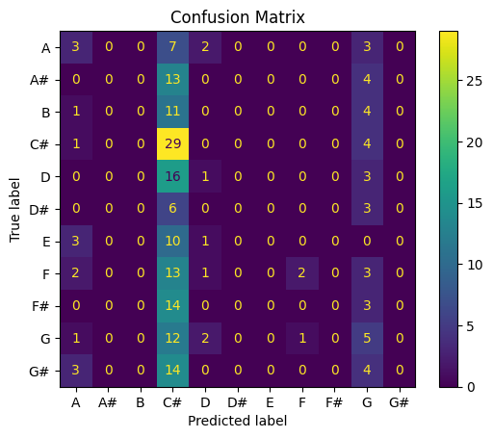
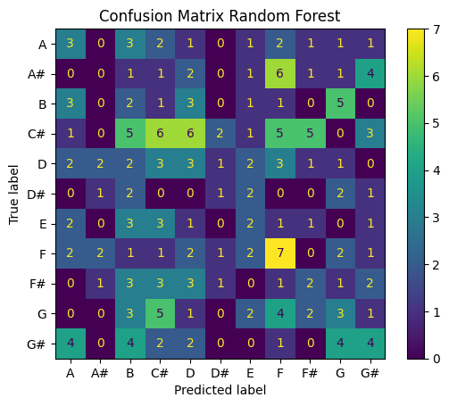

Examples of Models
Support Vector
Random Forest
KNN
We made 4 main models (Decision Tree matrix not shown)
Confusion matrices shown above
Shows where the model becomes inaccurate

Slide 8
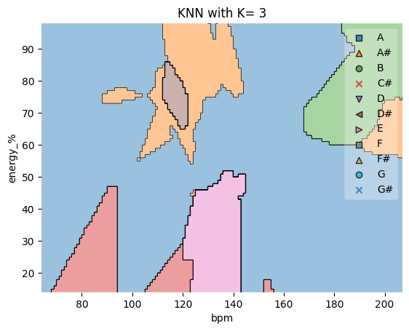
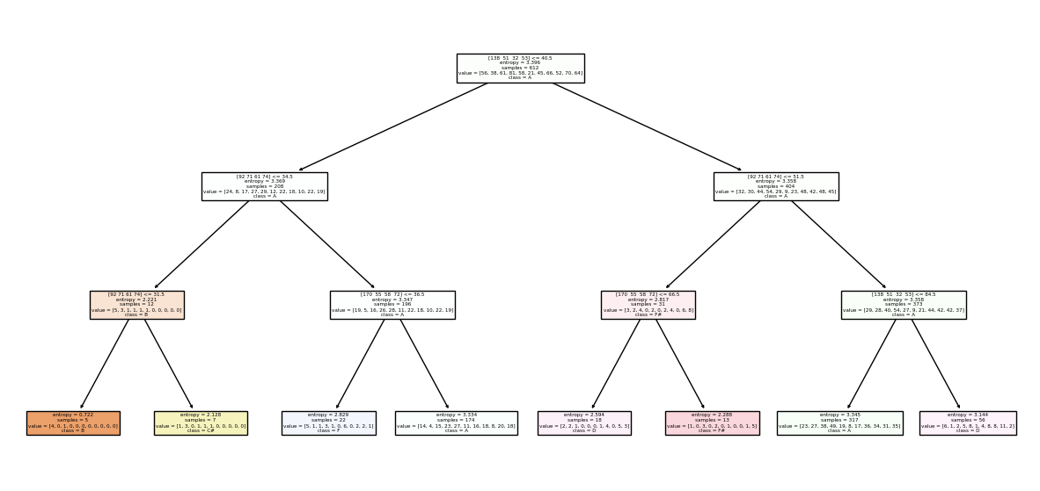
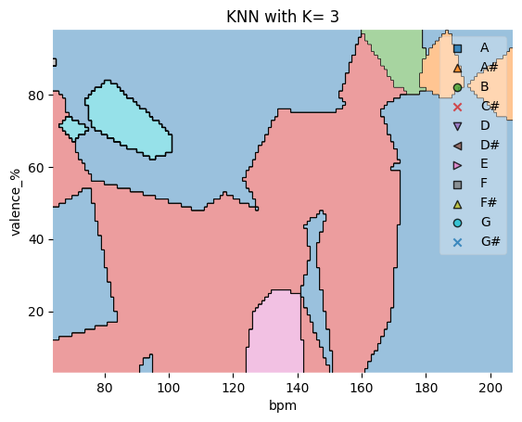
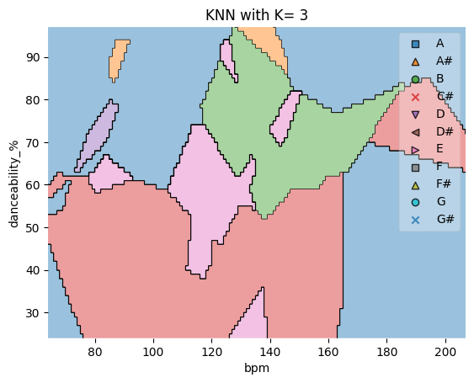
Model Results
KNN
Decision Tree
Models had low accuracy with the average being below 20%
Support Vector had highest accuracy
Problem was data columns didn’t correlate as well as previously thought

Slide 9
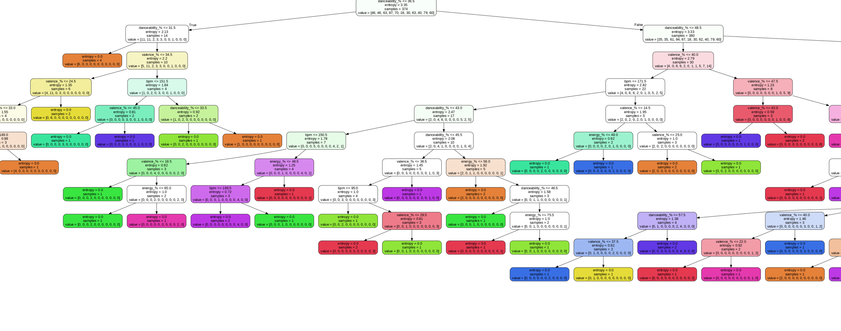
Model Results Continued
Start of Tree
Random Forest Tree

Slide 10
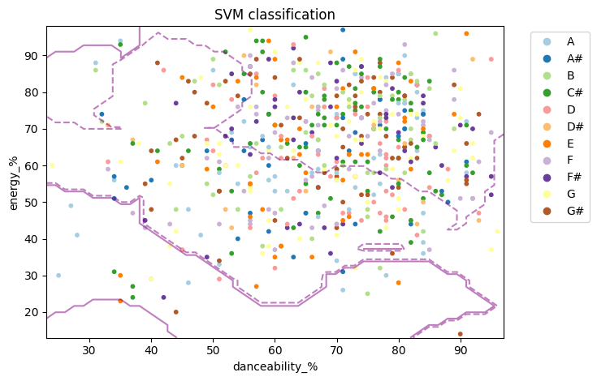
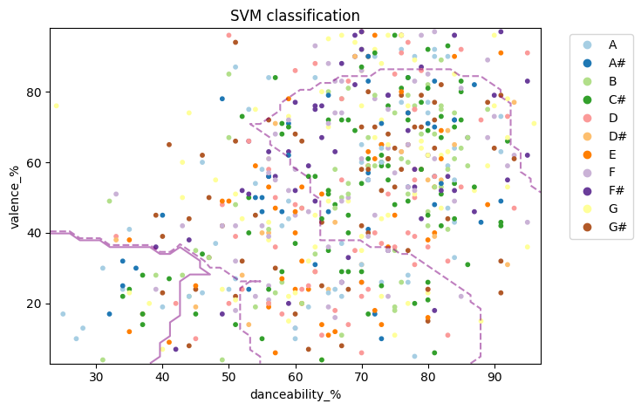
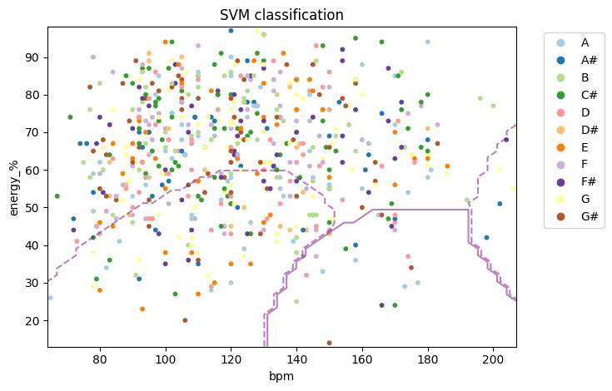
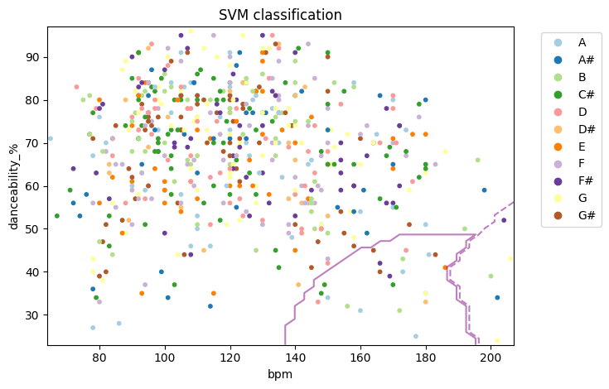
Model Results Continued
SVM visualization,
2 features at a time (For these graphs)
Most outstanding graphs shown

Slide 11
What Did We Learn and Future Work
We learned how to use KNN and other machine learning techniques in a real world dataset.
We were able to make some sort of predictions for classifying songs by key
As well as being able to show ML visuals or graphs using the dataset and it’s performance.
In terms of future work, we could adjust the features used to try to get the accuracy to increase, and see if different models will return higher accuracies

Slide 12
References
Kaggle: https://www.kaggle.com/datasets/nelgiriyewithana/top-spotify-songs-2023/data
Our Google Colab: https://colab.research.google.com/drive/1RsL8byWL1Vl-_8-BmtvJK_R7a-v1SSTf?usp=sharing
Scikit Learn Library Documentation: https://scikit-learn.org/stable/index.html
Matplotlib Library: https://matplotlib.org/

Slide 13
Questions?

